Slide 1
Clustering & PCA Assignment
Problem Statement - Identify top countries that are direst need of aid. My job is to categorise the countries using some socio-economic and health factors that determine the overall development of the country.

Slide 2
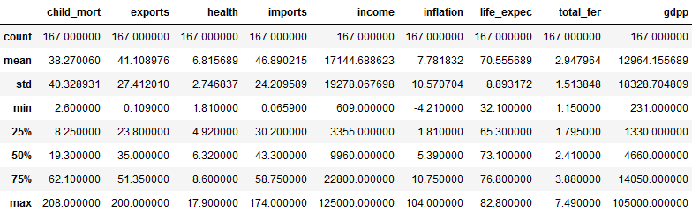
Current Dataset Summary :

Slide 3
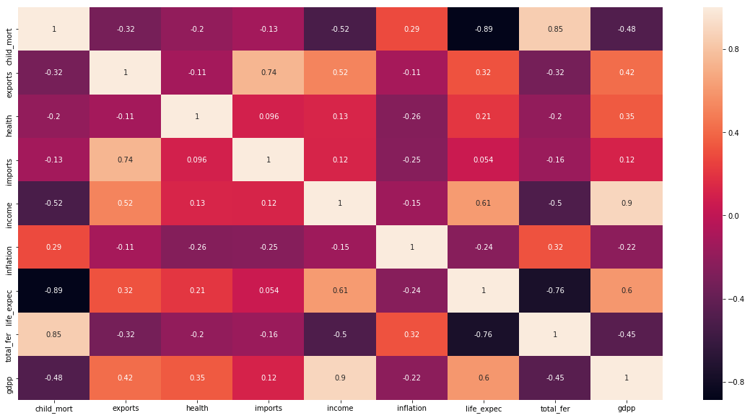
Correlation between different columns:

Slide 4
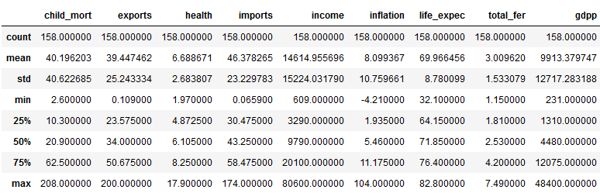
Post Outlier treatment Dataset Summary :

Slide 5
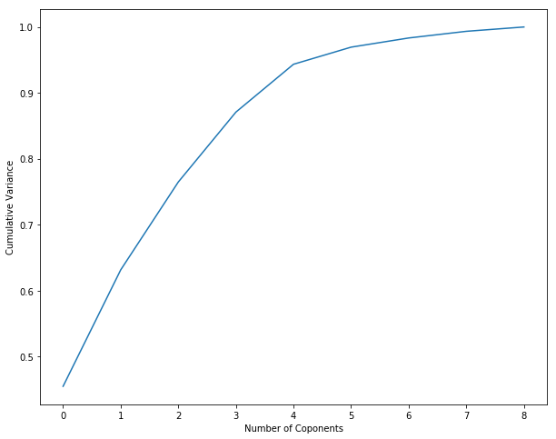
Scree Plot : Where we will go by 95%

Slide 6
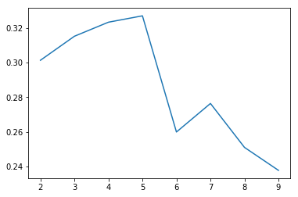
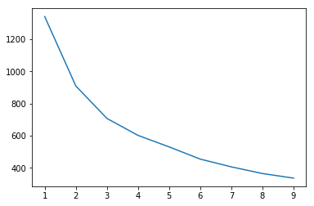
Comparison of Silhouette score & Elbow curve
Silhouette score – 5 Clusters
Elbow curve – 3 Clusters

Slide 7
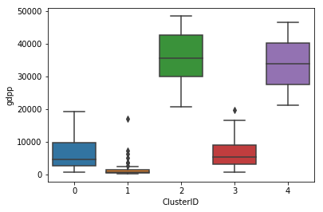
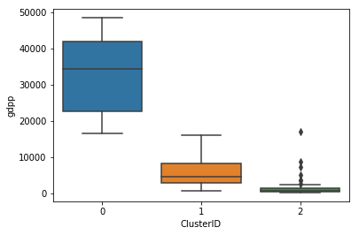
Comparison of LOW gdpp vs Cluster ID
Silhouette score
Elbow curve

Slide 8
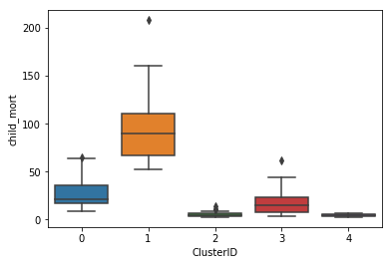
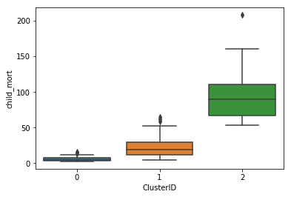
Comparison of HIGH child_mort vs Cluster ID
Silhouette score
Elbow curve

Slide 9
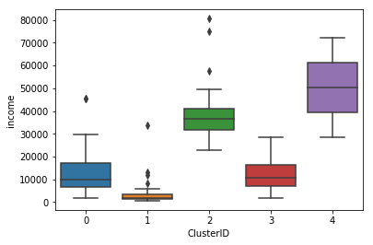
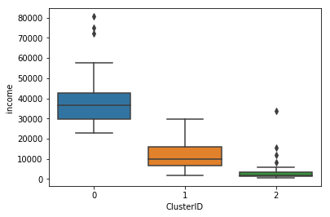
Comparison of LOW Income vs Cluster ID
Silhouette score
Elbow curve

Slide 10
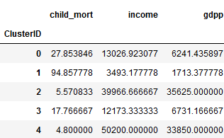
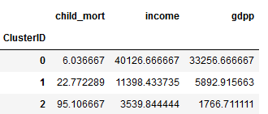
Comparison of Cluster Profile
Silhouette score
Elbow curve

Slide 11
Comparison of Country Names
Silhouette score
Elbow curve
0 Afghanistan
3 Angola
16 Benin
24 Burkina Faso
25 Burundi
27 Cameroon
30 Central African Republic
31 Chad
35 Comoros
36 Congo, Dem. Rep.
37 Congo, Rep.
39 Cote d'Ivoire
47 Equatorial Guinea
48 Eritrea
53 Gabon
54 Gambia
57 Ghana 61 Guinea
62 Guinea-Bissau
64 Haiti 77 Kenya
78 Kiribati 81 Lao
84 Lesotho 85 Liberia 89 Madagascar
90 Malawi 93 Mali
95 Mauritania
102 Mozambique 104 Namibia 107 Niger
108 Nigeria 110 Pakistan
119 Rwanda 122 Senegal
125 Sierra Leone
130 South Africa 135 Sudan 138 Tanzania 140 Timor-Leste 141 Togo 146 Uganda 156 Yemen 157 Zambia
0 Afghanistan
3 Angola
16 Benin 20 Botswana
24 Burkina Faso
25 Burundi
27 Cameroon
30 Central African Republic 31 Chad
35 Comoros
36 Congo, Dem. Rep.
37 Congo, Rep.
39 Cote d'Ivoire
47 Equatorial Guinea
48 Eritrea
53 Gabon
54 Gambia
57 Ghana 61 Guinea
62 Guinea-Bissau
64 Haiti 77 Kenya
78 Kiribati 81 Lao
84 Lesotho 85 Liberia 89 Madagascar
90 Malawi 93 Mali
95 Mauritania
102 Mozambique 104 Namibia 107 Niger
108 Nigeria 110 Pakistan
119 Rwanda 122 Senegal
125 Sierra Leone
130 South Africa 135 Sudan 138 Tanzania 140 Timor-Leste 141 Togo 146 Uganda 156 Yemen 157 Zambia

Slide 12
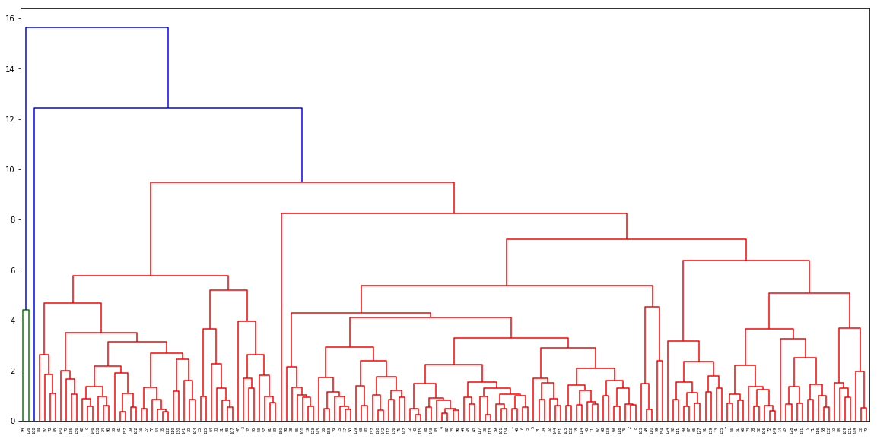
Hierarchical Clustering Analysis by Complete Linkage

Slide 13
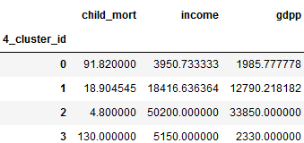
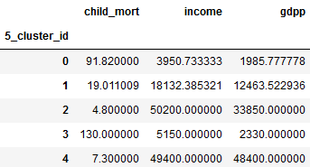
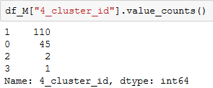
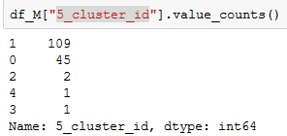
Hierarchical Clustering Analysis by Complete Linkage
4 Cluster
5 Cluster
Relationship between 2 types

Slide 14
Country list of Hierarchical Clustering Analysis
After reviewing the final list of Countries where NGO needs to decide how to use this money strategically and effectively is –
Nigeria ➔ Which is TOP in list
and the following countries are -
Afghanistan, Angola, Benin, Botswana, Burkina Faso, Burundi, Cameroon, Central African Republic,
Chad, Comoros, Congo, Dem. Rep., Congo, Rep., Cote d'Ivoire, Equatorial Guinea, Gabon, Gambia,
Ghana, Guinea, Guinea-Bissau, Haiti, Iraq, Kenya, Kiribati, Lao, Lesotho, Liberia, Madagascar, Malawi,
Mali, Mauritania, Micronesia, Fed. Sts., Mozambique, Namibia, Niger, Rwanda, Senegal, Sierra Leone,
South Africa, Sudan, Tanzania, Timor-Leste, Togo, Uganda, Yemen, Zambia

Slide 15
Conclusion :- After reviewing K-Means and Hierarchical Clustering list of final counties it presents same list in both the approaches and we can conclude with the final list of Countries where we need to provide aid.
Thank You!!!

